Slide 1
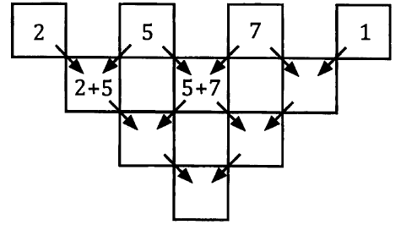
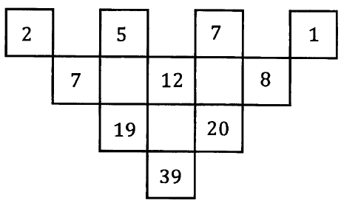
Pyramid Puzzles
The pyramid pattern is completed by adding the 2 and the 5 and putting the answer in the box below, adding the 5 and the 7 and putting the answer in the box below and so on.

Slide 2
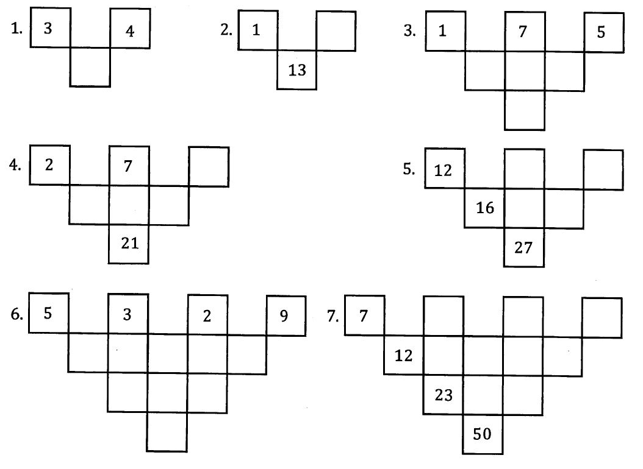
Pyramid Puzzles

Slide 3
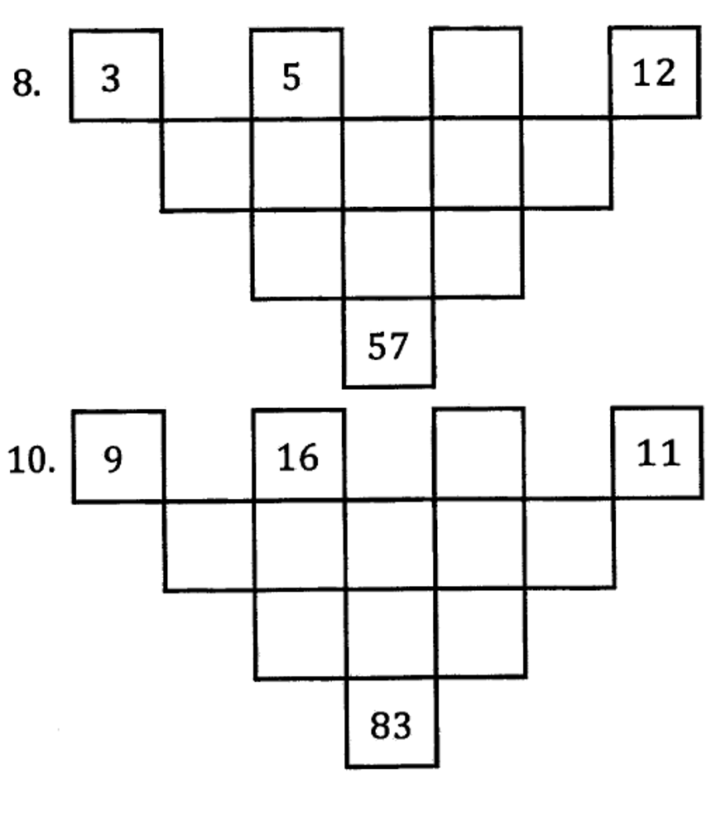
Pyramid Puzzles

Slide 4
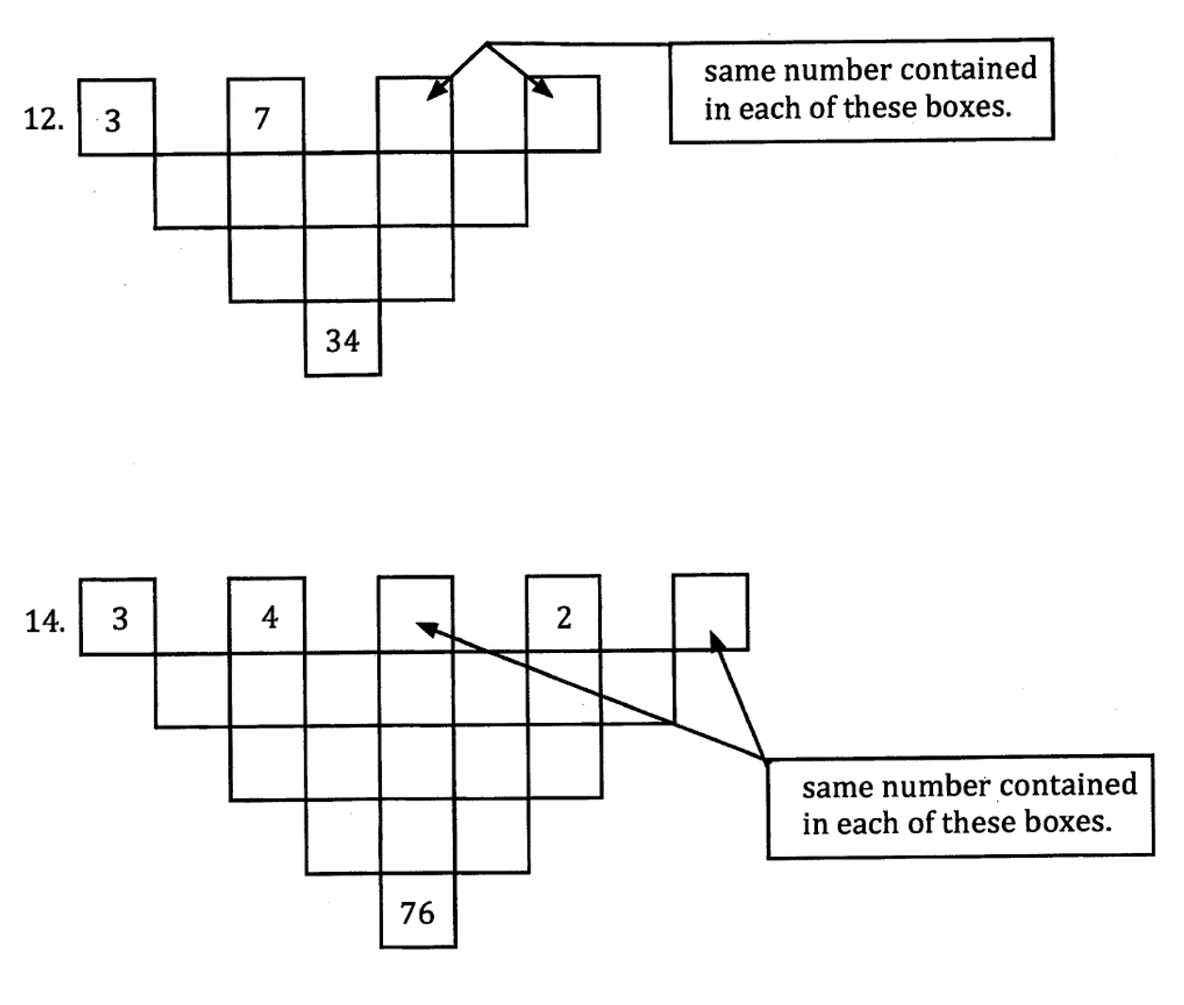
Pyramid Puzzles
Now do exercise 7A

